Slide 1

Assessing a Multiple Regression Model
Reading: 3.2
exercises: Ch 3. 19-21
Assigned: hw 7
Producer: dr. mario
img credit: alex riegert-waters

Slide 2

t-Tests for Coefficients
Hypotheses:
$H_{0}:β_{i}=0$
$H_{a}:β_{i}≠0$
Test Statistic:
$t^{∗}={{\hat{β}}_{i}}/{SE_{{\hat{β}}_{i}}}$
P-Value: Non-directional and Use t-Distribution with n-k-1 d.f.

Slide 3
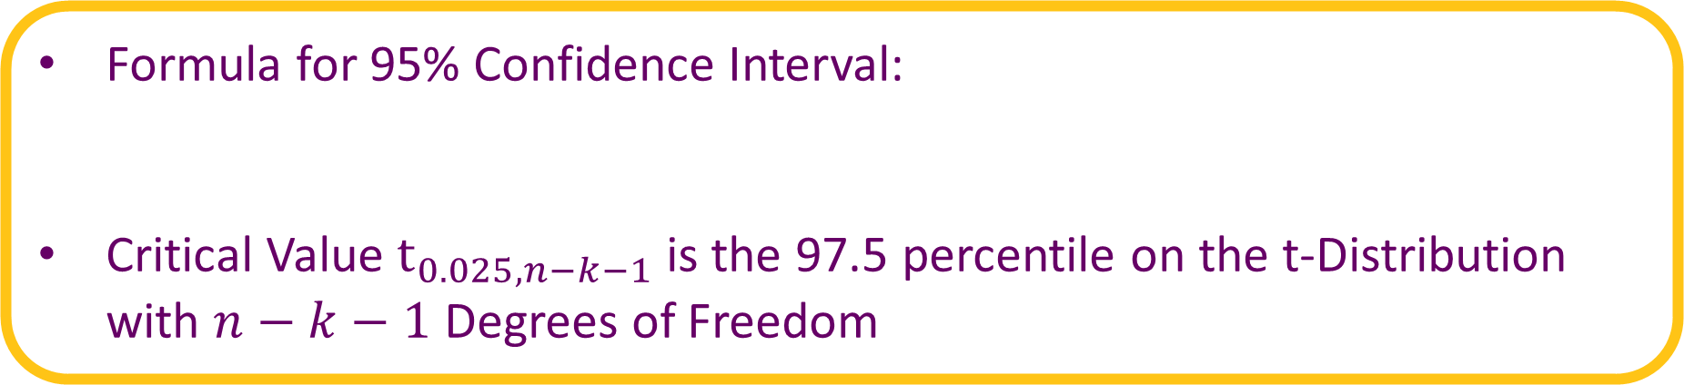
Confidence Intervals for Coefficients
Formula for 95% Confidence Interval:
Critical Value $t_{0.025, n−k−1}$is the 97.5 percentile on the t-Distribution with $n−k−1$ Degrees of Freedom
$${\hat{β}}_{1}±t_{0.025, n−2}∗SE_{\hat{β_{1}}}$$

Slide 4
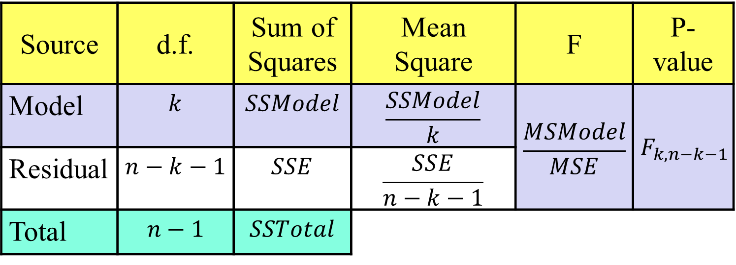
ANOVA Table
Updated for Multiple Linear Regression
Formulas for SSModel, SSE, and SSTotal are Same
Source | d.f. | Sum of Squares | Mean Square | F | P-value
Model | $$k$$ | $$SSModel$$ | $$\frac{SSModel}{k}$$ | $$\frac{MSModel}{MSE}$$ | $$F_{k,n−k−1}$$
Residual | $$n−k−1$$ | $$SSE$$ | $$\frac{SSE}{n−k−1}$$
Total | $$n−1$$ | $$SSTotal$$

Slide 5

ANOVA F-Test
Tests the Overall Effectiveness of the Linear Model as a Whole
Hypotheses:
$H_{0}:β_{1}=β_{2}=…=β_{k}=0$
$H_{a}:at least one β_{i}≠0$
Test Statistic: Make sure you divide by the correct degrees of freedom.
P-value: Use F-Distribution with k numerator degrees of freedom and n-k-1 denominator degrees of freedom.

Slide 6


Coefficient of Determination
Recall Formula:
Book Uses $R^{2}$ instead of $r^{2}$ Since Finding R-squared is Not as Simple as Just Calculating Correlation and Squaring It
$R^{2}$ can be Found by Squaring the Correlation between $y$ and $\hat{y}$
Problem: Adding a new predictor variable into your linear regression model will never decrease $R^{2}$ (make it worse)
$$R^{2}=\frac{SSModel}{SSTotal}=1−\frac{SSE}{SSTotal}$$

Slide 7
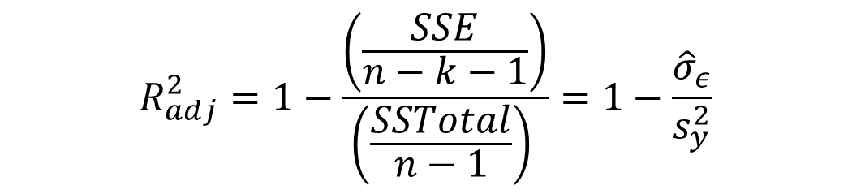
Adjusted Coefficient of Determination
Formula for Adjusted R-Squared:
SSE will Never Increase as You Add Variables to Your Model
Sample Variance of Y Is Completely Unaffected by Model
Complexity Measured By k Influences adjusted R-squared
$$R_{adj}^{2}=1−\frac{\left(\frac{SSE}{n−k−1}\right)}{\left(\frac{SSTotal}{n−1}\right) }=1−\frac{{\hat{σ}}_{ε}}{s_{y}^{2}}$$

Slide 8

Adjusted Coefficient of Determination
Adding an Extra Variable to the Model Will Likely Cause SSE to Decrease or Stay the Same (Extremely Unusual)
However, MSE may Actually Increase Since the Error Degrees of Freedom in the Denominator May Decrease More
$$MSE=\left(\frac{SSE}{n−k−1}\right)$$

Slide 9
Confidence and Prediction Intervals
Confidence and Prediction Intervals are Still More Valuable Than Point Predictions
More Difficult to Calculate by Hand
Reason 1: Uncertainty in Each Slope
Reason 2: Model is Not Just a Straight Line on a Cartesian Plane

Slide 10
Supplement for Lecture 14
Fit Multiple Linear Regression Model to Data
Interpreting Individual Slopes and t-Tests
Standard Error of Regression and adjusted R-squared
ANOVA table and F-Test
Confidence Intervals and Prediction Intervals

Slide 11
Thank You
Make Reasonable Decisions

